Slide 1
Marketing Research on Training & Development Programs using STP Strategy VARNIKA TYAGI Social Media Marketing Intern Epitome TRC

Slide 2
Table of content
About us
Program Offered
Cost Comparison with other Vendors
Benefits
Extra Offerings with Epitome
STP Marketing Strategy
Segmentation
Targeting/ Positioning
Target Audience
Marketing Mix

Slide 3
About Us
Epitome TRC is always a helping hand to enrich your existing skills and broaden your thoughts, scope to have an excellent career growth and development. We believe in our pupil to enhance the skills with our explicit modules with technical-non technical expertise.
We are running lot of programs to enhance the knowledge of individuals. Please see the below data for your reference
80 Corporate Programs
49 Training Courses
88 Strategic Partners
436 Companies We Helped
We are also providing different services
Business Consulting
Information Technologies
Recruitment & Staffing
Training & Development

Slide 4
Program Offered
Program Name | Mode | Location | Job Function | Fees | More Information
Course AZ-900 - Microsoft Azure Fundamentals | Online/Offline | PAN India | Administrator | $645 EUR | https://docs.microsoft.com/en-us/learn/certifications/courses/az-900t01
Course AZ-204: Developing Solutions for Microsoft Azure | Online | PAN India | Developer | $1950 USD | https://docs.microsoft.com/en-us/learn/certifications/courses/az-900t00
Course DP-203: Data Engineering on Microsoft Azure | Online/ Offline | PAN India | Data Engineer | $2990 USD | https://docs.microsoft.com/en-us/learn/certifications/courses/dp-203t00

Slide 5
Cost Comparison with other Vendors

Slide 6



Benefits
AZ-900
Azure Fundamental Knowledge Proof
Prepare Yourself for New Job Roles with AZ-900
Your career will accelerate in no time
You will earn a Microsoft Certification Batch
AZ-204
Better Understanding of Microsoft Azure
Validate Your Skills
Upgrade Your Career
You will earn a Microsoft Certification Batch
DP-203
Increase in demand for Data Engineers
In terms of job prospects and earning, a certification leads to a rampant gain in both.
Upon earning a certification, 26 percent report job promotions and 35 percent of technical professionals say getting certified led to salary or wage increases.
You will earn a Microsoft Certification Batch

Slide 7
Extra Offerings with Epitome
There extra benefits which we are providing as compare other vendors present in market
We are in top 5 certified company in India for Training & Development
We have top certified trainer with more than 10 + years of industry experience.
24x7 support on Software application used in training.
For any student query we will provide one to one support from faculty via phone or email or zoom connect.
We will provide notes for each module and topics which we will cover during the course
We will create group between student to complete the task and based on that we will reward the team.
We will offer classes with online or offline mode as per the student convenient.
Hands-on experience with technology.

Slide 8
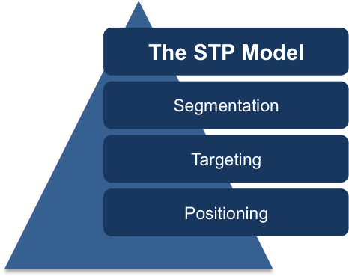
STP Marketing Strategy
The STP marketing model (Segmentation, Targeting, Positioning) is a familiar strategic approach in modern marketing.
It is one of the most commonly applied marketing models in practice, with marketing leaders crediting it for efficient, streamlined communications practice.
STP marketing focuses on commercial effectiveness, selecting the most valuable segments for a business and then developing a marketing mix and product positioning strategy for each segment.

Slide 9
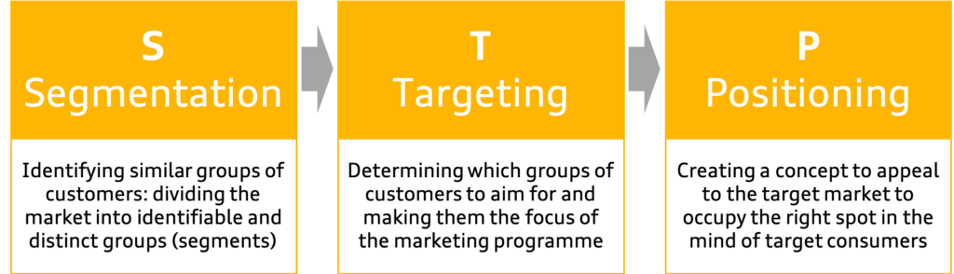
Contd..

Slide 10
Segmentation
We are targeting the IT Industry & Students with Computer Science background in India or any part of the world.
We are currently targeting the below customers
Wipro
Infosys
Accenture
HCL
Happiest Mind
For student we have one Student Segment where we included the audience which are from computer science background
BCA
B..Tech in IT or Computer Science
BSC in Computer Science
MS in Computer Science
M.Tech in Computer Science
We will be offering the certification from Microsoft
This training program is for the below sub group
Professionals & Student ( either Male or Female) will be in a Age group of 18+
We are targeting more than 10 Lakh profession/students to be certified on the technology.

Slide 11
Targeting
We are targeting the technology specialist or student with computer science background who are interested to learn cloud services like below with relevant experience in technology
The target audience will be both Male and Female
Age of the target audience will be more than 18+
Any professional with 1+ years of experience in any Technology like Microsoft or Oracle etc.
Positioning
We will be offering different plans for the training like Basic, Standard or Premium based on the customer choice
We will develop a marketing strategy which will compare with other vendors and the same we will show to the customer with all benefits.
If company have more certified professionals then when company went for any project bidding that time they will show this as achievement for a company

Slide 12
Target Audience
AZ-900
Candidates with non-technical backgrounds looking to demonstrate their foundational knowledge of cloud services.
Candidates includes those involved in selling or purchasing cloud based solutions and services or have some involvement in cloud based services and solutions.
Candidates with a technical background looking to validate their foundational level knowledge of the cloud.
AZ-204
Candidates are expected to have between 1 and 2 years professional development experience and experience with Microsoft Azure.
Candidates will be expected to be able to write code using an Azure supported language; such as C#, Java, or others
DP-203
Cloud Architects
Azure DBAs
Azure Administrators
Clients to design and build strategy

Slide 13
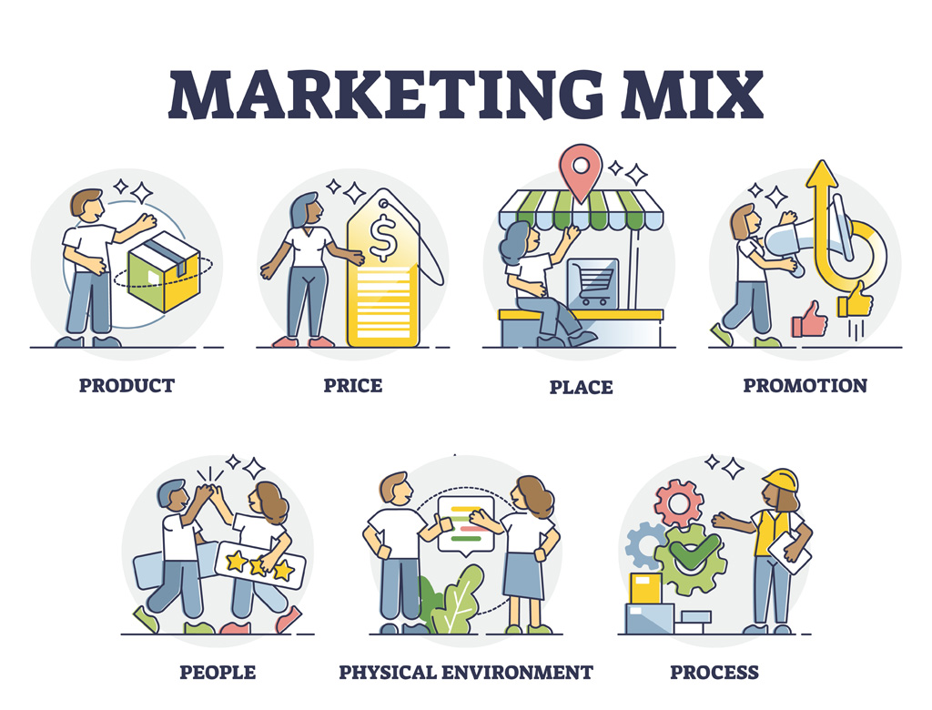
Marketing Mix
The term “marketing mix” is often associated with another acronym: the 4Ps. The two have become almost interchangeable since Philip Kotler popularized the concept. “4Ps” is the English acronym for the 4 operational facets of marketing that make your company’s positioning a reality. They all begin with the letter “p” in English:
“Product”: all aspects related to the product (the Product Policy)
“Price”: the price positioning of your product concerning its competitors (the Price Policy)
“Promotion”: the aspects related to promotion such as advertising or the ways to make people aware of the existence of the product (the Communication Policy)
“Placement”: aspects related to the distribution of your product (the Distribution Policy)

Slide 14
Thank you

